Slide 1
Principal Components Analysis ( PCA)
When dimensionality increases, data becomes increasingly sparse
Density and distance between points, which is critical to clustering, outlier analysis, becomes less meaningful
The possible combinations of subspaces will grow exponentially
PCA reduces number of dimensions in data and find patterns in high-dimensional data
Example applications:
Face recognition
Image compression
Gene expression analysis

Slide 2
Covariance
Variance
- Variance measures the spread or dispersion of a single random variable around its mean or expected value.
- Variance can be thought of as a measure of the uncertainty or volatility associated with a single random variable.
Covariance
- Covariance measures the degree to which two random variables change together.
Positive covariance indicates that when one variable increases, the other tends to increase as well.
Negative covariance indicates that when one variable decreases, the other tends to decrease.
- Zero covariance indicates no linear relationship between the variables, though it doesn't necessarily mean there's no relationship at all.
In summary, variance measures the spread of a single random variable, while covariance measures the joint variability of two random variables. Variance is a measure of dispersion within a single variable, whereas covariance is a measure of association between two variables.

Slide 3
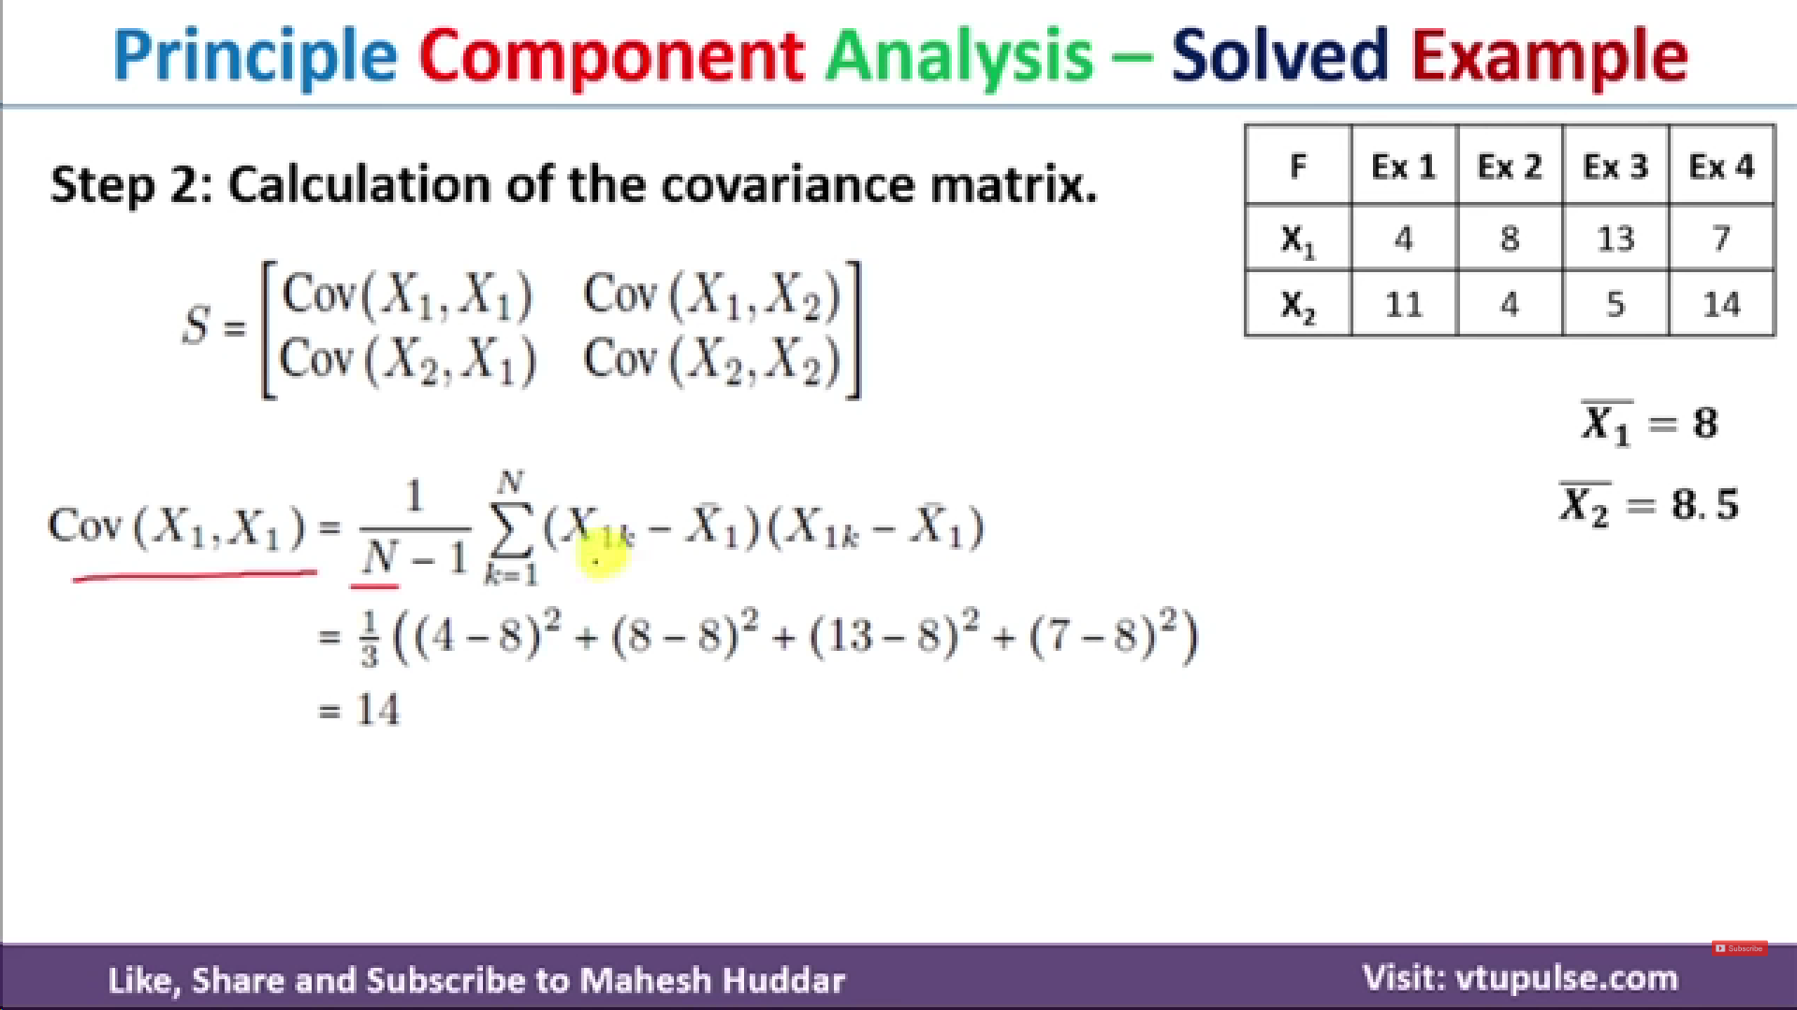


Slide 4
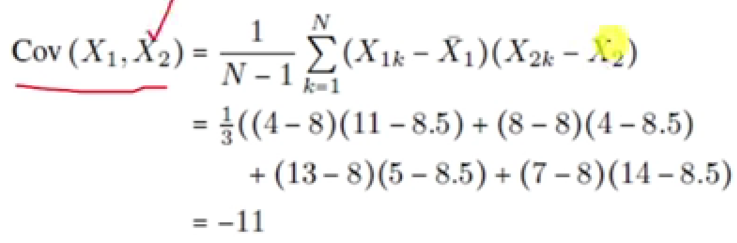
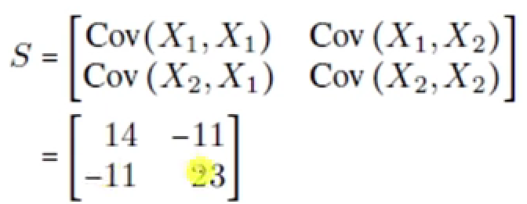
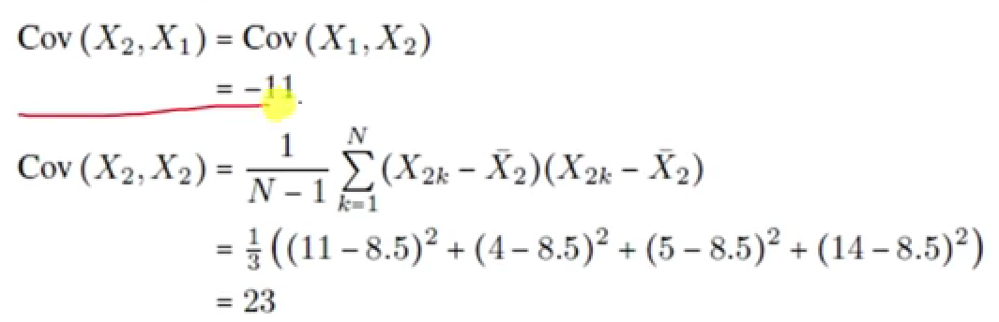
Covariance Matrix

Slide 5
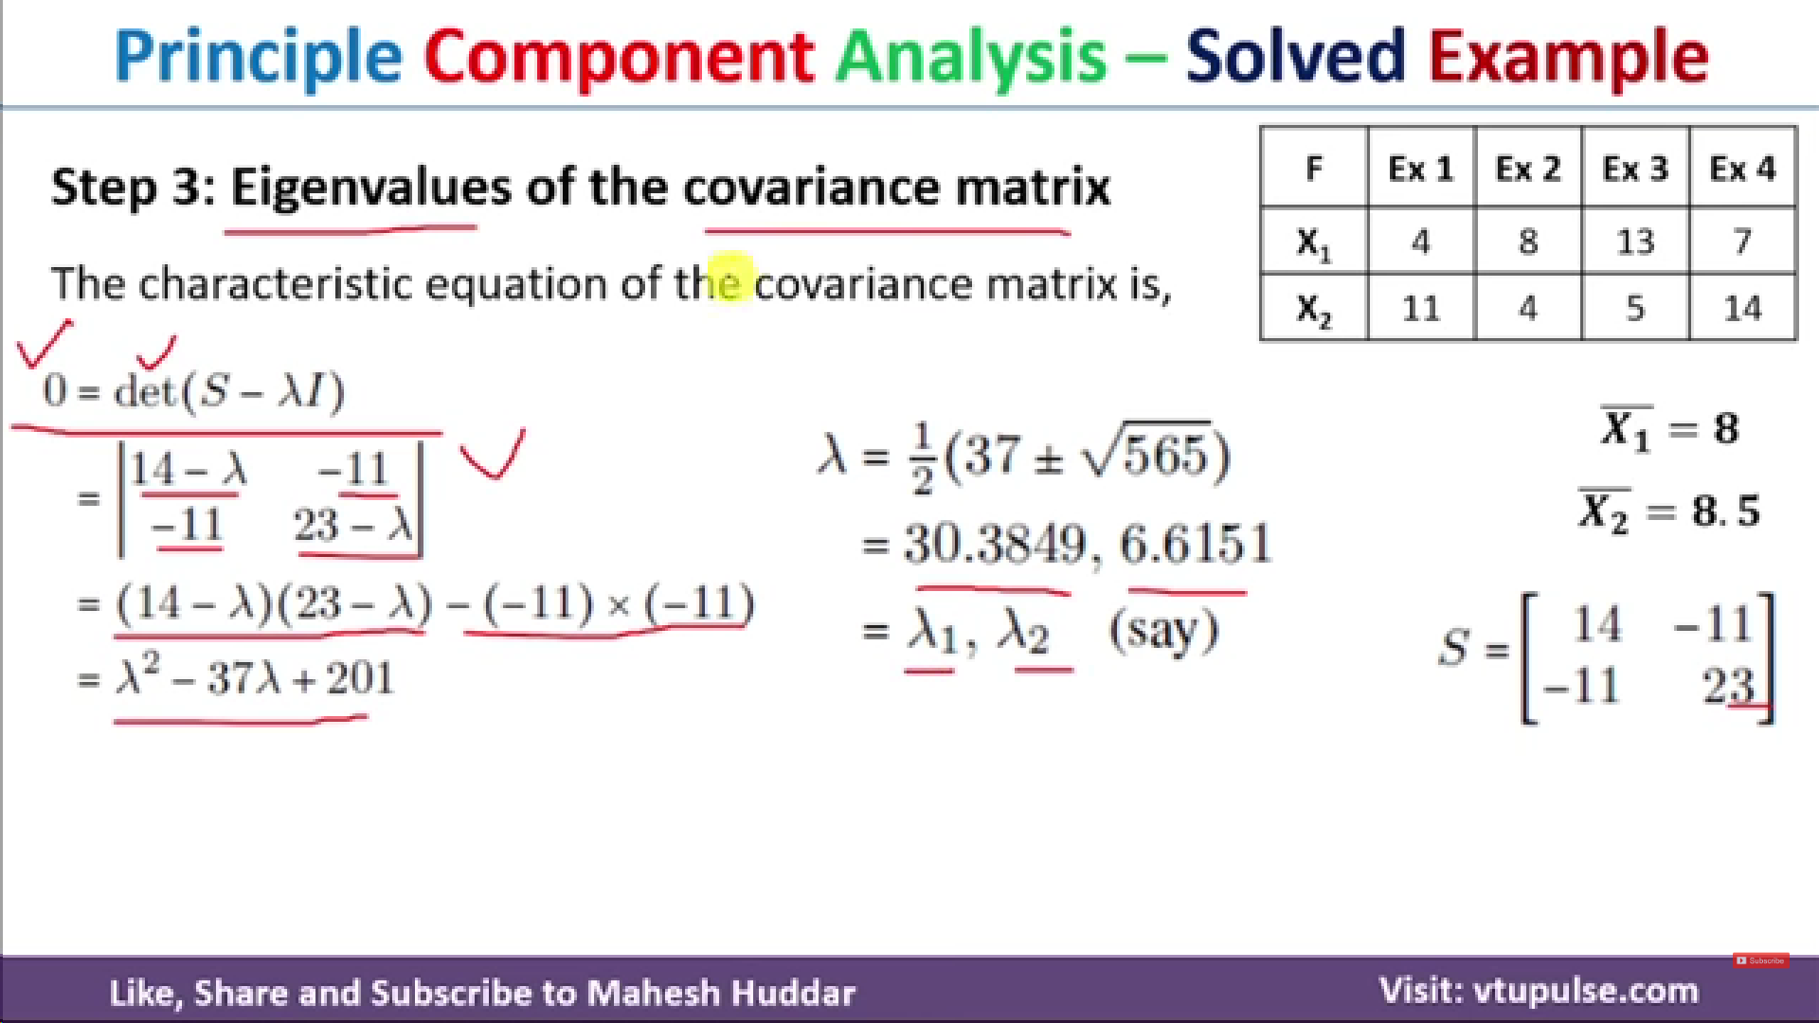

Slide 6
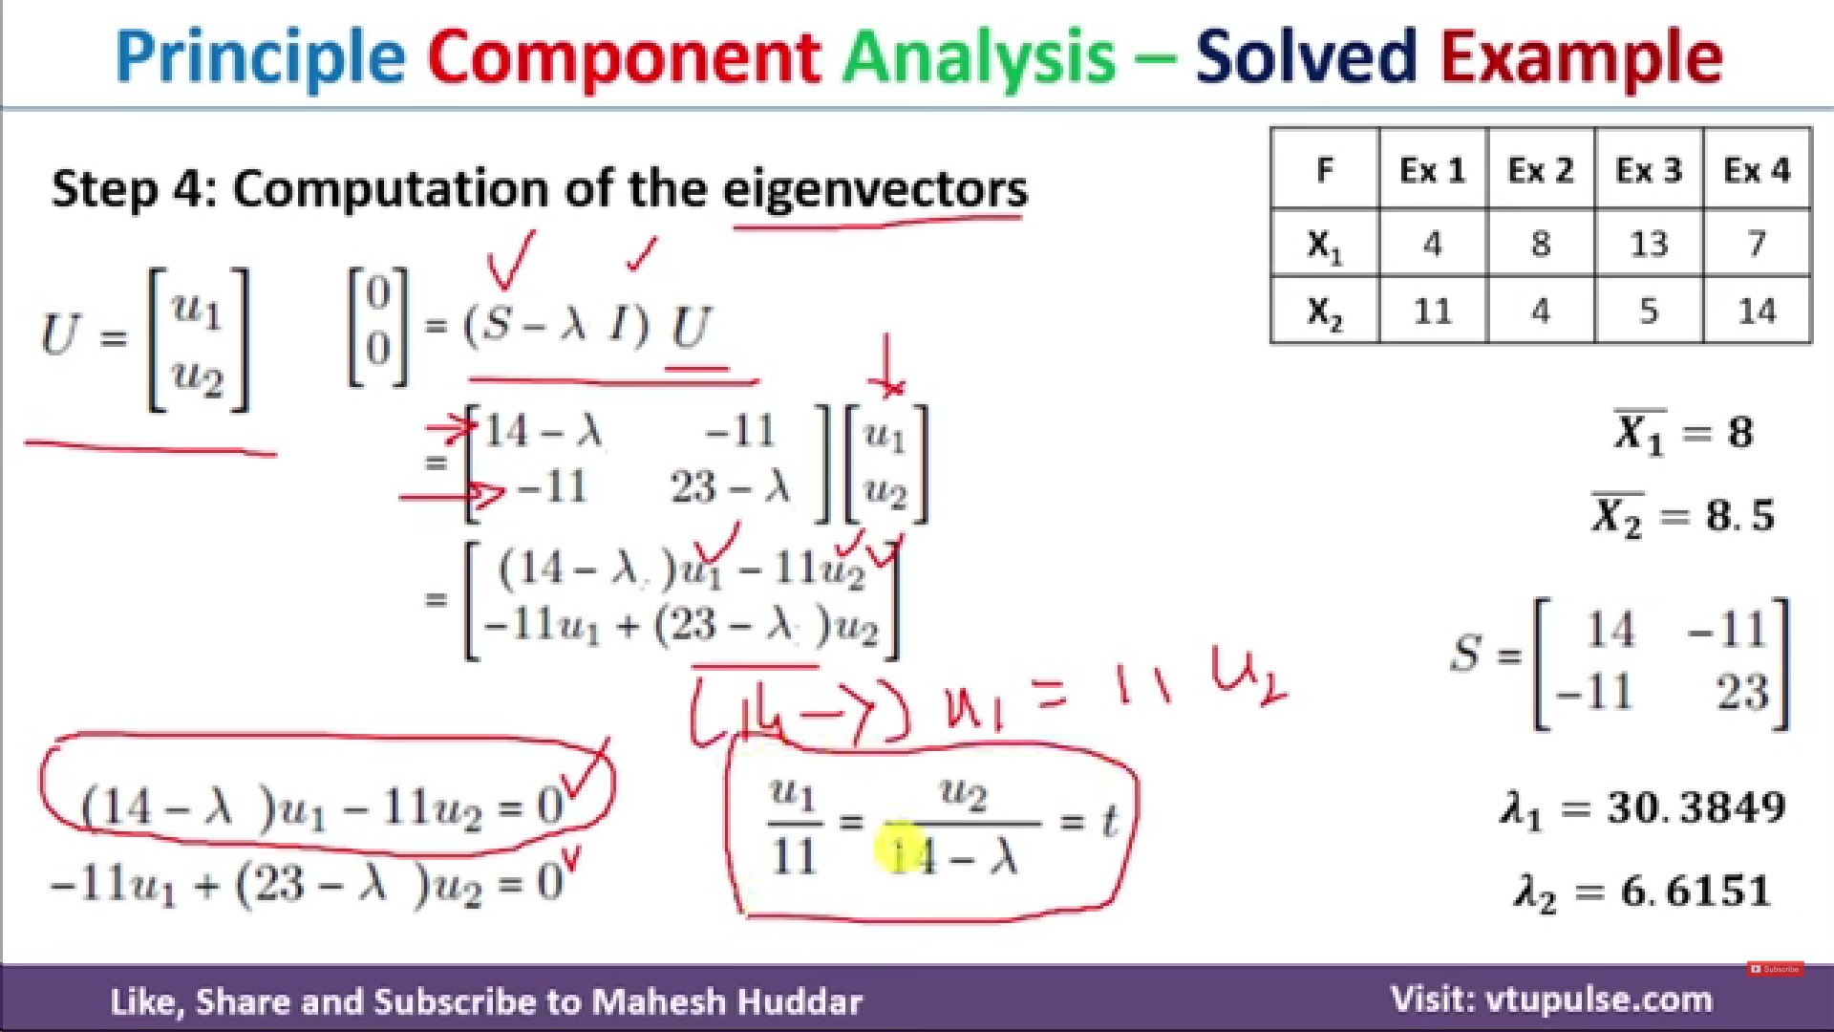

Slide 7
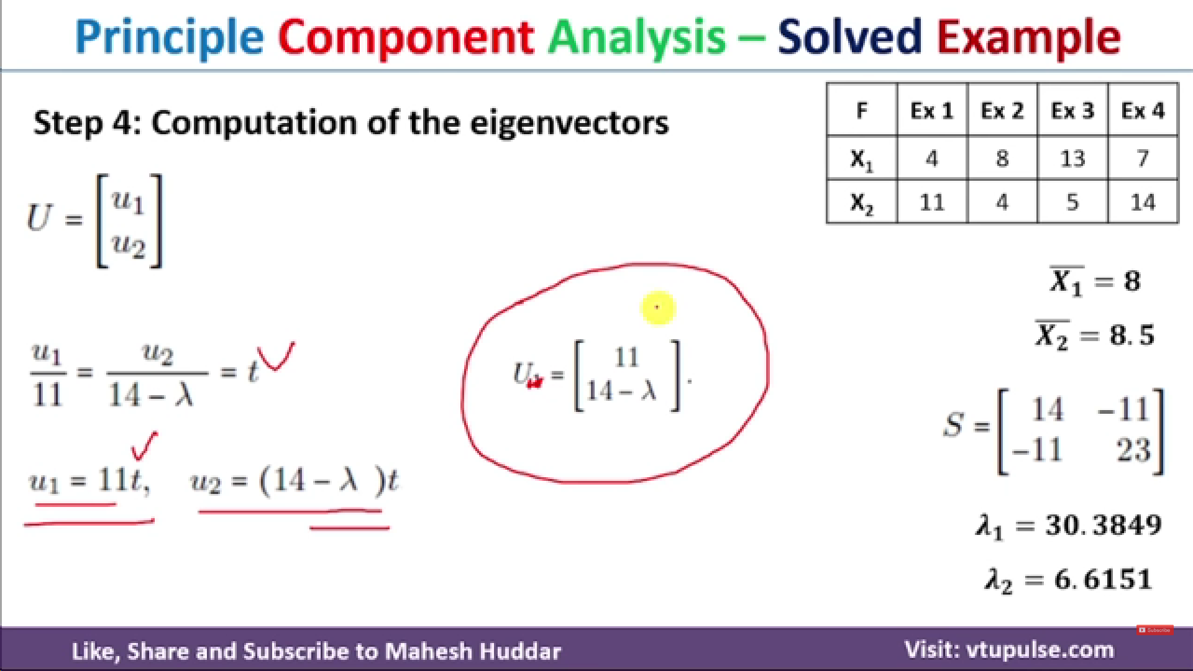

Slide 8
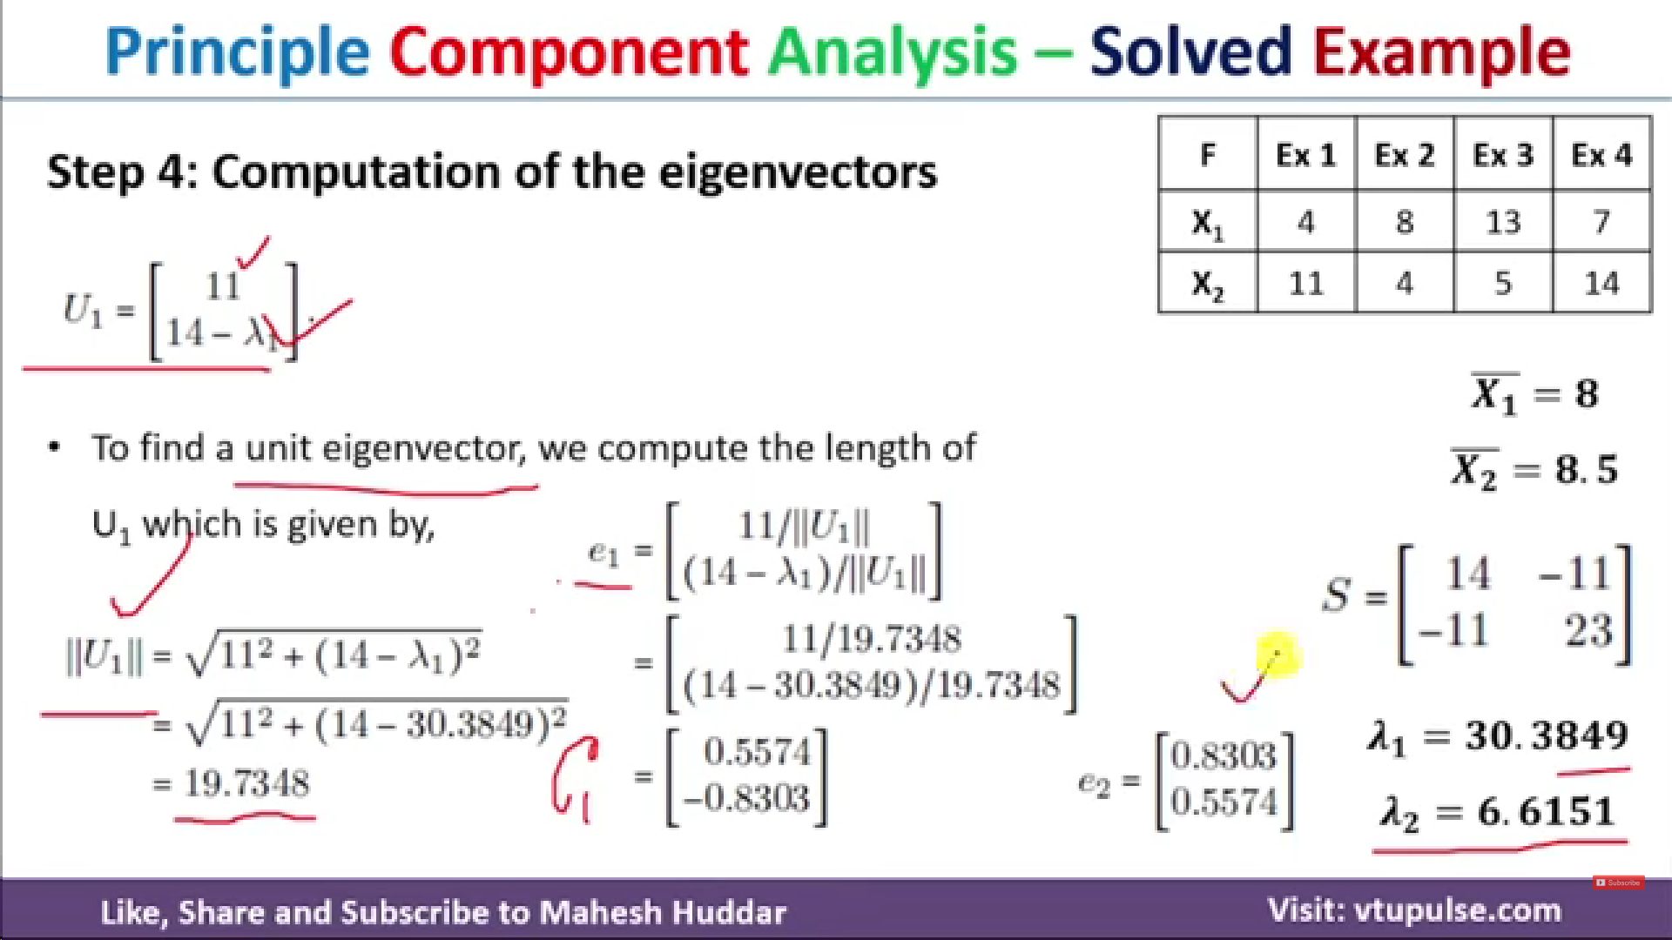

To calculate e2, put lambda2 value in ||U2|| formula and then find e2 =[11/||U2|| , (14-lambda2)/||U2||]

Slide 9
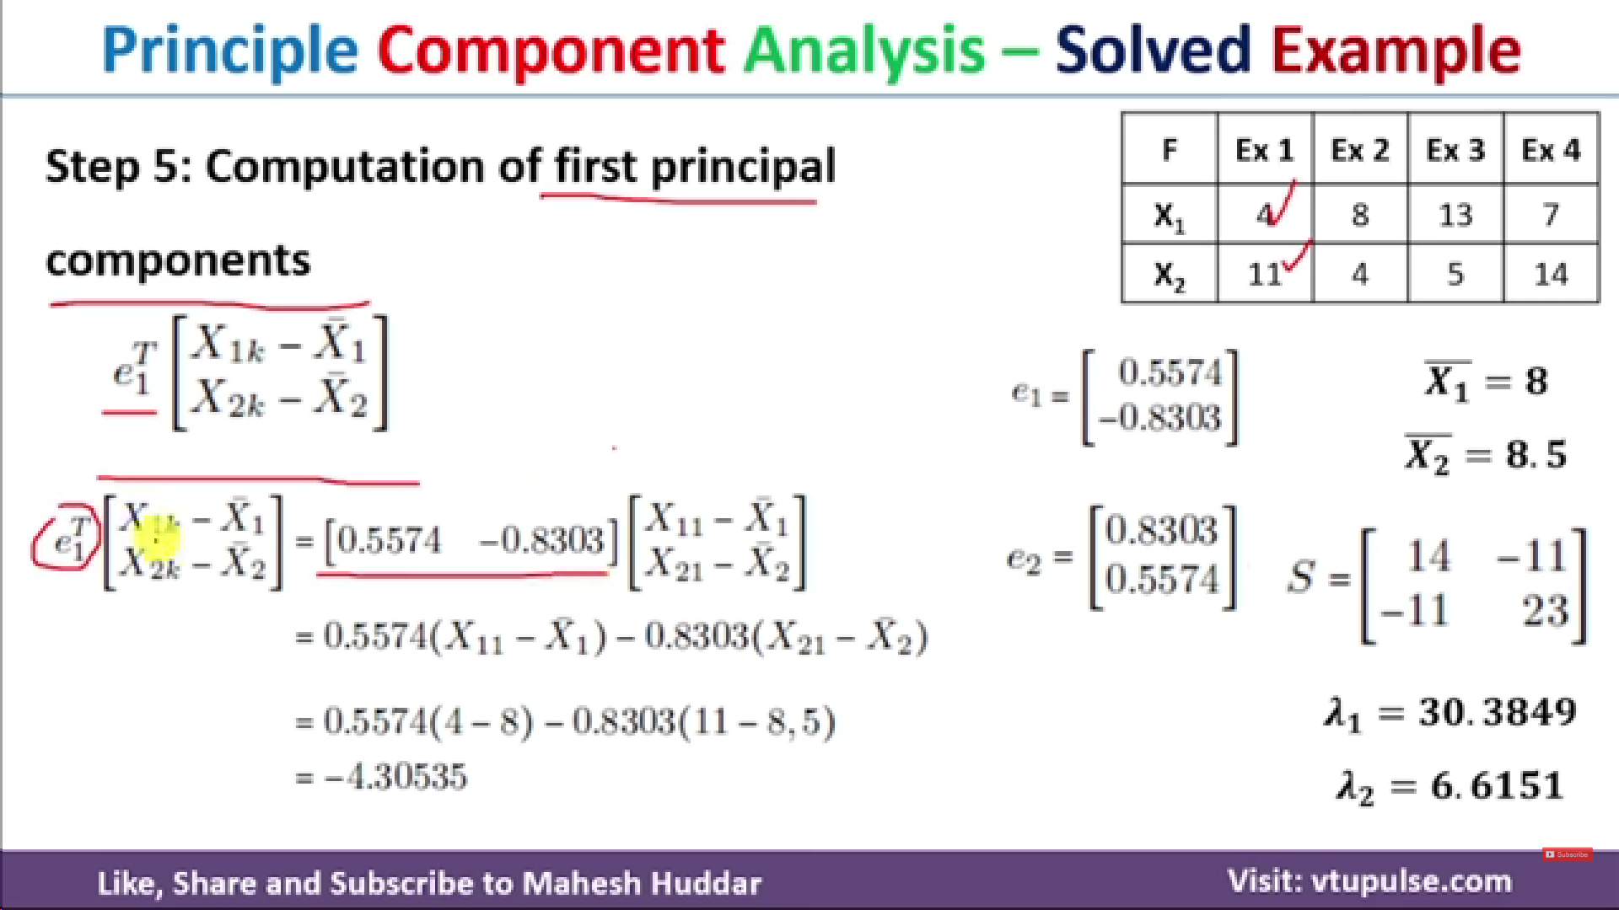
Similarly compute for all other points in X1

Slide 10
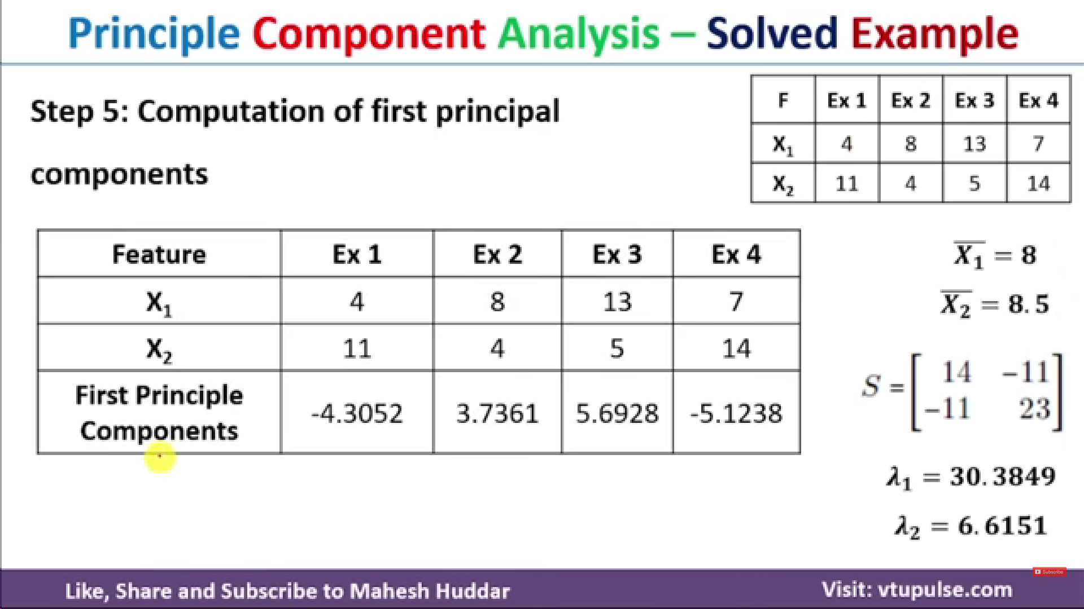

Slide 11
Exercise
1. You are given a 2-D dataset X comprising 4 data points (6,-4), (-3,5), (-2, 6) and (7, -3). Suppose we use PCA to project the sample points onto a one-dimensional space.
i. Derive the one-dimensional subspace that we are projecting onto.
ii. For each of the four sample points in X, mention the coordinate that the point is projected in principal coordinate space.

